Slide 1


Customer Prediction
Anthony Rodrigues
July, 2025

Slide 2
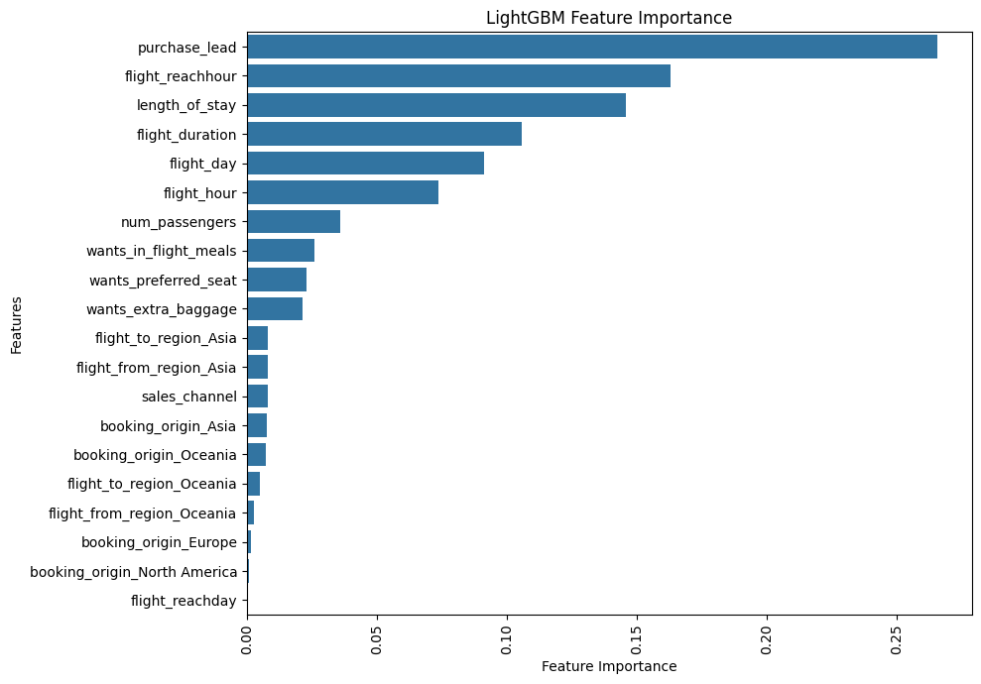
Model Evaluation Report
The three most important features identified were length_of_stay, flight_duration, and purchase_lead. In contrast, the features booking_origin, flight_from_region, and flight_to_region were found to be less significant.
The most important metrics for this project is Recall followed by F1 which came to be 86% and 90% respectively.
Recall indicates Better to target more customers (some false positives) than miss interested ones, Missing engaged customers can harm long-term relationships
F1 score indicates a balanced approach - combines precision and recall. Good single metric for model comparison among both target classes.

